Slide 1









Introduction to the course
Basics statistics for biomedical research course
UEB – VHIR & GRBIO
Mata Bofill¹, Jordi Cortes¹, Santiago Pérez-Hoyos^{2,3},Álex Sánchez^{2,3}
1 Departament d’Estadistica i Investigacio Operativa. UPC
2. Unitat d’Estadística i Bioinformàtica (UEB) VHIR
3 Departament de Genetica, Microbiologia i Estadistica UB

Slide 2
Contingut
Who are we?
What do we do?
Where are we?
Why this course
Objectives
Methods
Contents
Logistics

Slide 3


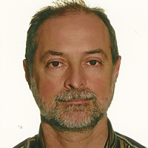

Who are we?
This is a joint course taught by members of the Grup de Recerca en Bioestadistica i Bioinformatica (GRBIO) (http://grbio.upc.edu)
GRBIO
EIO, UPC
GME, UPC
UEB, VHIR

Slide 4
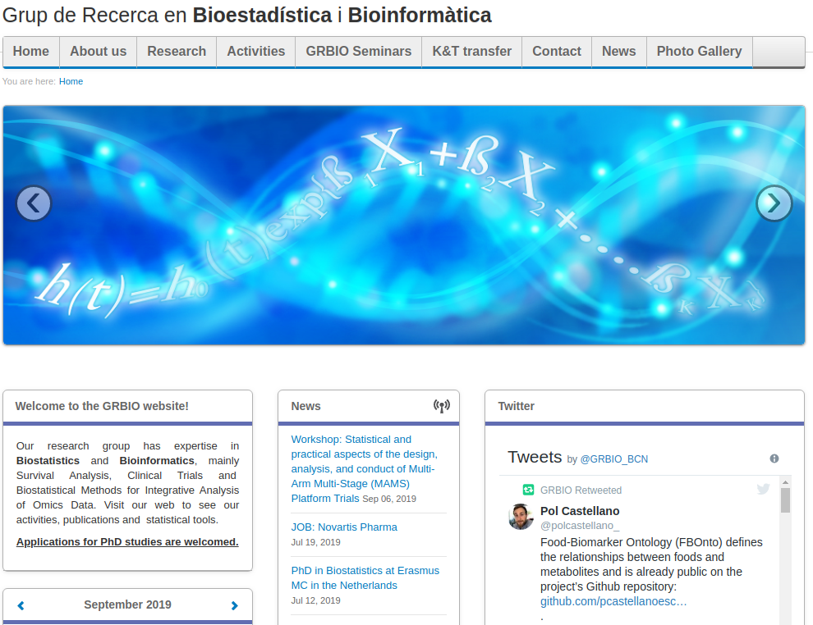
The GRBIO (http://grbio.upc.edu)

Slide 5
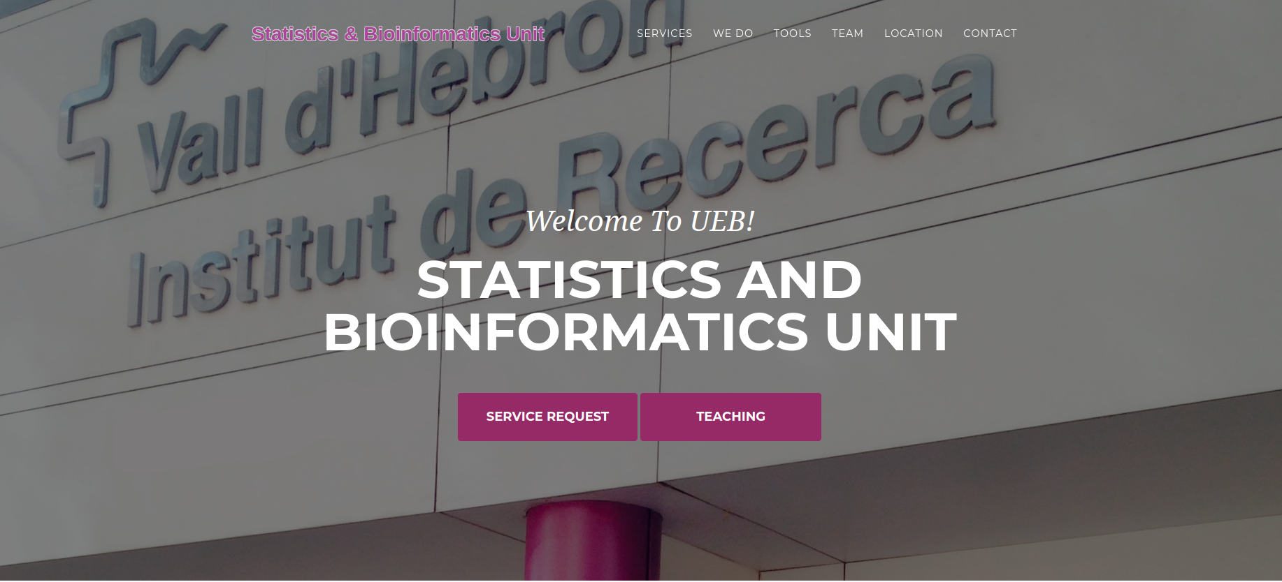
The UEB (http://ueb.vhir.org)
Notes:
Provide statistical, methodological and bioinformatic support for biomedical and clinical research, mainly in the VH but also to other scientists.
Contribute to training in statistics and bioinformatics for clinical and biomedical researchers by teaching a variety of courses ranging from one-day to teaching in the VHIR’s Msc.
Promote and be actively involved in innovation and development in statistics and bioinformatics, specially in anything that may revert in improvement of the unit’s mission development.

Slide 6
Why this course
A huge quantity of, often complex, data is generated in clinical or lab research.
In order to be able to extract information from data we must rely on statistics.
Statistical methods and tool range from those that are relatively simple and accessible to more complex sophisticated models.
The main goal of this course is to provide an overview which is good enough to
Help you to analyze your own data, when it makes sense
Suggests you to contact us (or other experrts) when it makes sense
Learn when to do each thing :-)

Slide 7
As the master said ...
“Hiring a statistician after de data has been collected is like hiring a physician when a patient is in the morgue: she might be able to tell you what went wrong , but she is unlikely to be able to fix it”
R.A. Fisher

Slide 8
Objectives
Main objective of the course is to provide a general overview of the principal statistical methods that can be useful in biomedical research and daily practise
At the end of the course you should be able to...
Recognize the main problems from a statistical point of view
Identify the basic methods to solve these problems
To use basic tools to carry out properly their own analysis
Identify when to apply each method
Be able to ask a professional statistician using the proper terminology to understand the solutions when problems increase their complexity

Slide 9
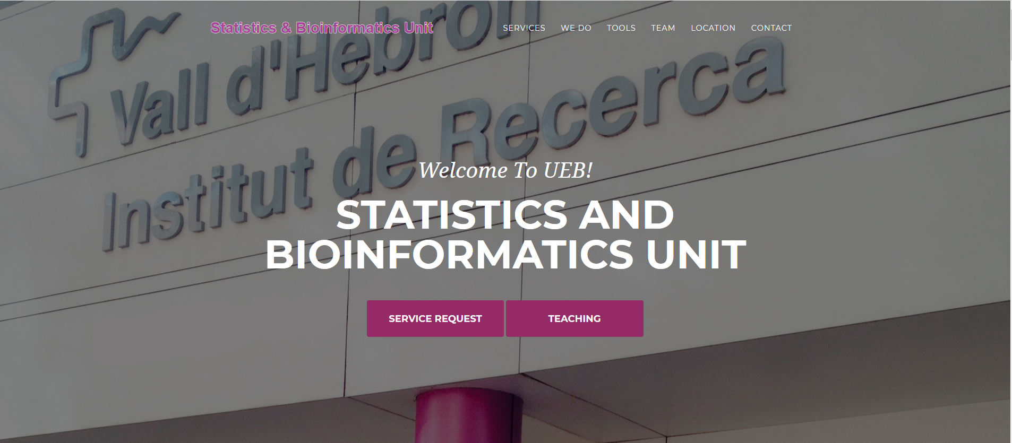
ueb.vhir.org

Slide 10
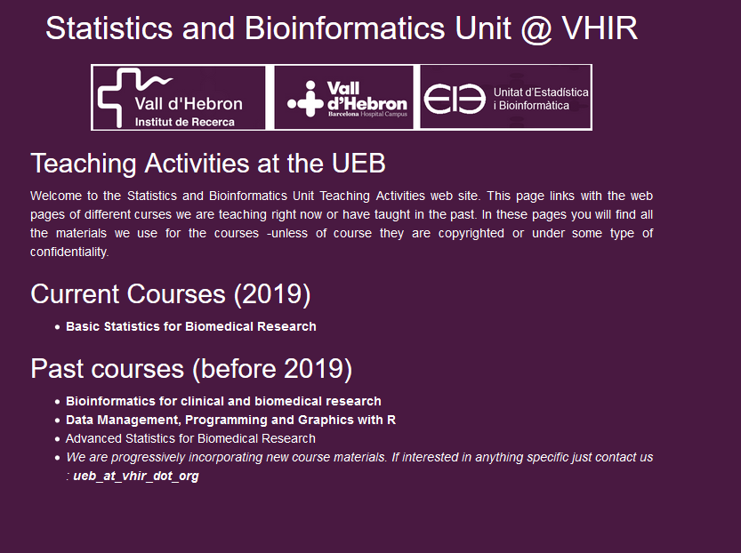
Course web access

Slide 11
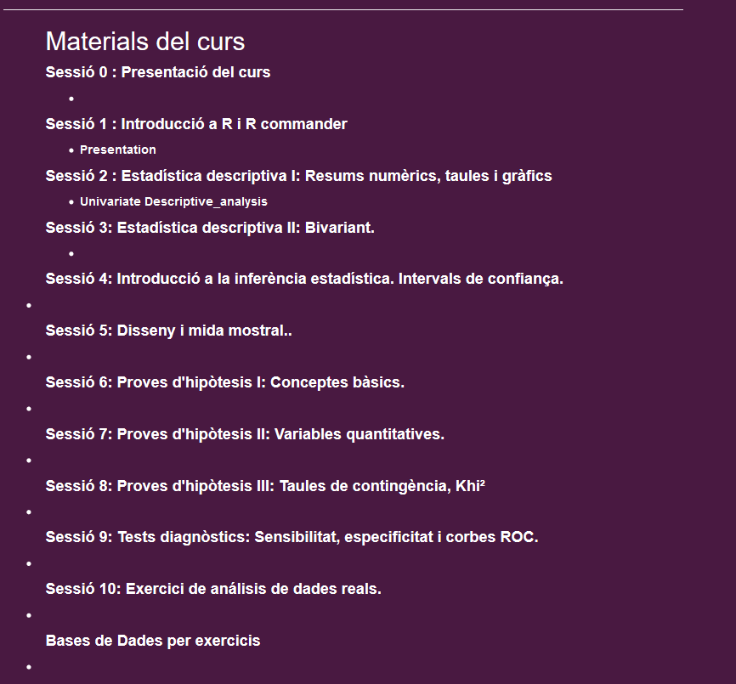

Slide 12
Methodology
This course is about applied statistics
We work with real data examples
Data analysis with R and R commander.
Theory is important , but discussion of real problems is what leads to understanding.
Program is flexible and may be adapted to your needs.

Slide 13



The statistical (scientifical?) process
Nature
Real data
Generate
Observed data
“Studied nature”
Statistical methods

Slide 14
Statistical approaches
Descript
Estimation
Summary measures. Graphs. CIs
Compare
Hypothesis testing
Relate or predict
Modelling or Regression

Slide 15
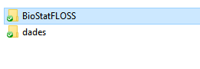
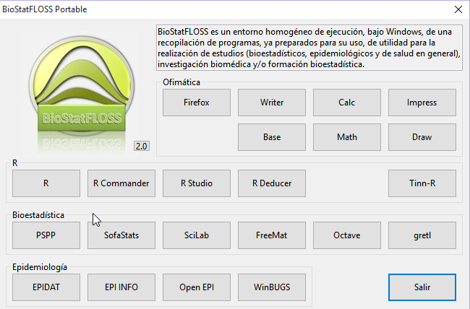
Materials

Slide 16
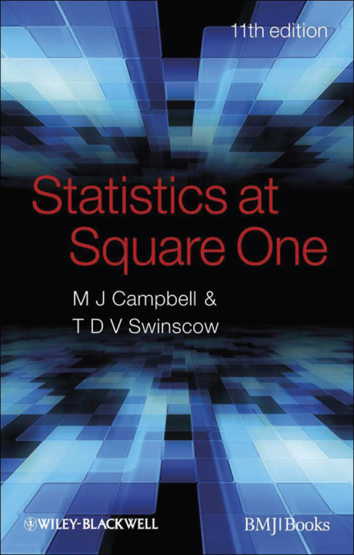
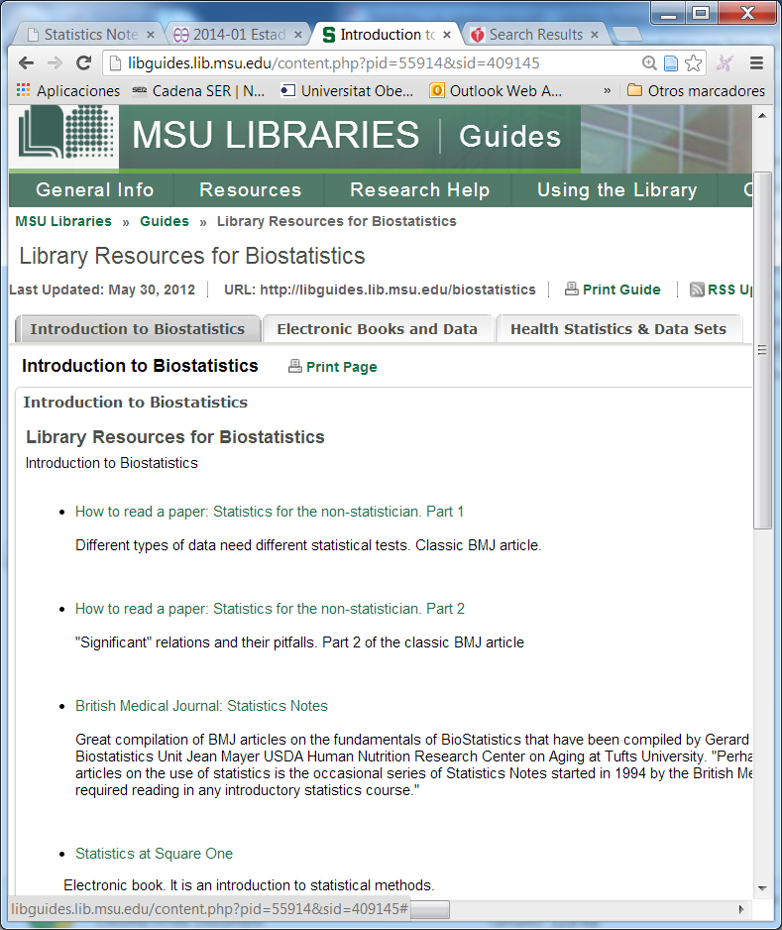
Resources
R and R-commander: Free software
Resources about basic statitistics
Course slides and exercise datasets
Some text or reference material

Slide 17
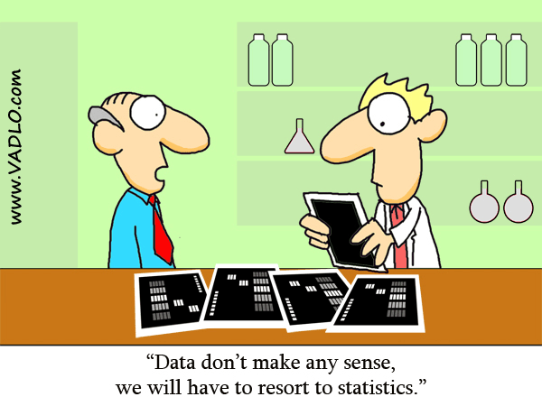
Have a good course !!!!

